Slide 1

CMR COLLEGE OF ENGINEERING & TECHNOLOGY
Kandlakoya ,Medchal, Hyderabad - 501401
Department of Computer Science and Engineering
Song Recommender Chat Bot
Team members:
20H51A05J3-Pulipati Anusha
20H51A05J5-Nayani Sai Aditya
20H51A05J7-Swarna BhagyaShree
Under esteemed guidance of
Guide Name
Dr.S.Siva Skandha

Slide 2
Outline
Abstract
Introduction
Literature survey
Existed system
- Problems in existed system
Research Objective of Presentation
Problem Definition
Research work
- Proposed system architecture
- Methods
- Comparison of Proposed system with an existed system
Performance Measure
Results
Conclusion
Future Work
Notes:
2

Slide 3
Abstract
Notes:
3

Slide 4
ABSTRACT
Technology has a great impact on every part of lives, which also includes our day-to-day habits. In present scenario, fields like artificial intelligence and machine learning are on great boom.
With the help of advancement in these fields, large number of people are interacting through the system via chat bots and voice assistants.
Considering above factors, this project is aimed to implement the NLP based Chat Bot Song Recommender System that includes chat bot to assist user and recommend songs using the Natural Language Processing. In this project we will discuss methodology, algorithms and the flow of the system.

Slide 5
INTRODUCTION
Notes:
5

Slide 6
Introduction
Now-a-days, we all are living in the time where we know that nothing is certain. Same goes with our mind, at regular instances of time our mood, our choices and our priorities changes.
Considering the constant changing behavior of human being we have developed our system. We have made our system considering that the humans experience frequently changes in their mood and somehow, at particular moment of time, frequently changing of mood would also result in change in mood of music of their choice.
Hence, with the help of our system you can listen music according to your mood. In addition, we have also provided the facility to user to chat with the chat bot after all texting makes conversation between chat bot and user more interactive.
Notes:
6

Slide 7
Literature Survey
Notes:
7

Slide 8
Existed system
Collaborative filtering involves collecting information from many users and then making predictions based on some similarity measures between users and between items. This can be classified into user-based and item-based models.
In item-based model it is assumed that songs that are often listened together by some users tend to be similar and are more likely to be listened together in future also by some other user. According to user-based similarity model users who have similar listening histories, i.e., have listened to the same songs in the past tend to have similar interests and will probably listen to the same songs in future too
Example:Spotify , Saavan.
Notes:
8

Slide 9
Research Objective
Notes:
9

Slide 10
Research objective
To Develop a chat bot application using Artificial Intelligence technology which can recommend songs from Spotify website based on user mood.
Automates process of song recommendation by training Dataset.

Slide 11
Problem Definition
Notes:
11

Slide 12
Problem Definition
With the advancement of technology fast processing of requests is more important for engaging users with better service considering user engagement in song recommendation system a effective method is required for supporting song recommendation system which need to suggest list of songs based on user request.

Slide 13
Research Work
Notes:
13

Slide 14
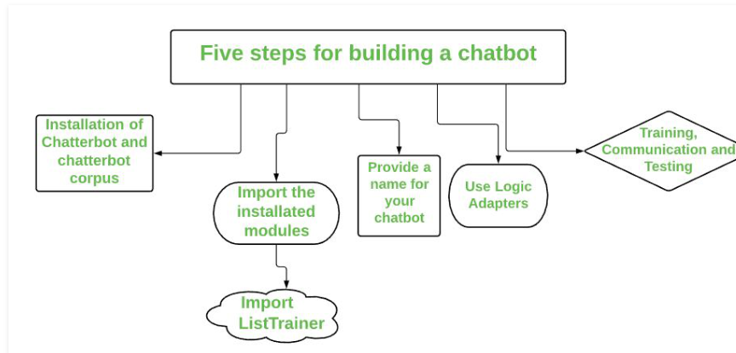
Proposed system architecture

Slide 15
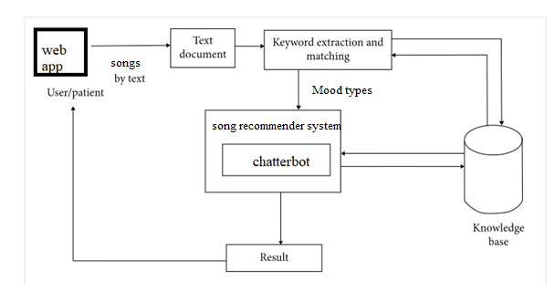

Slide 16
Proposed Methods
Chatter bot using NLP Technique is developed which can recommend user list of songs based on user requested input.
User can Train dataset based on own interest and based on trained corpus recommend songs are displayed to user.
Flask frame work is used to develop a chatter bot website.

Slide 17
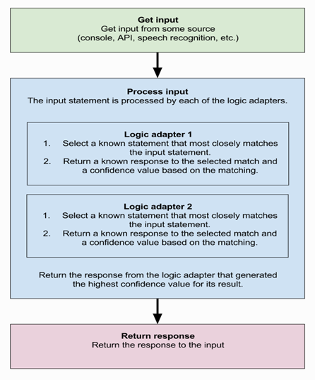
Proposed Methods

Slide 18
Proposed Methods
DATASET:
Text file with questions and answers are used as dataset in this project. Song recommendation related queries with links and answers are given in text file which is prepared by taking data from Spotify website. Data set can be increased by adding more records to the txt files.
Pre-processing:
In this step required chat bot libraries are initialized and text data is taken as input to NLP module and preprocessing is performed. Data set question and answers are stored in database. While application I executed preprocessing is performed.

Slide 19
Proposed Methods:
Chat Bot WebSITE:
Flask framework is used to develop chat bot application which has input option from user and question posted by user is processed and verified with the answer which is trained using NLP model and result is displayed to user based in input question.
Development Process:
ChatterBot is a library in python which generates a response to user input. It used a number of machine learning algorithms to generates a variety of responses. It makes it easier for the user to make a chatbot using the chatterbot library for more accurate responses. The design of the chatbot is such that it allows the bot to interact in many languages which include Spanish, German, English, and a lot of regional languages. The Machine Learning Algorithms also make it easier for the bot to improve on its own with the user input.

Slide 20
Performance Measure:
Application Works With Large Amount Of Dataset.
Data Can Be Trained With URLS.
Accuracy Of Returning Trained Data Is Above 90 Percent.

Slide 21
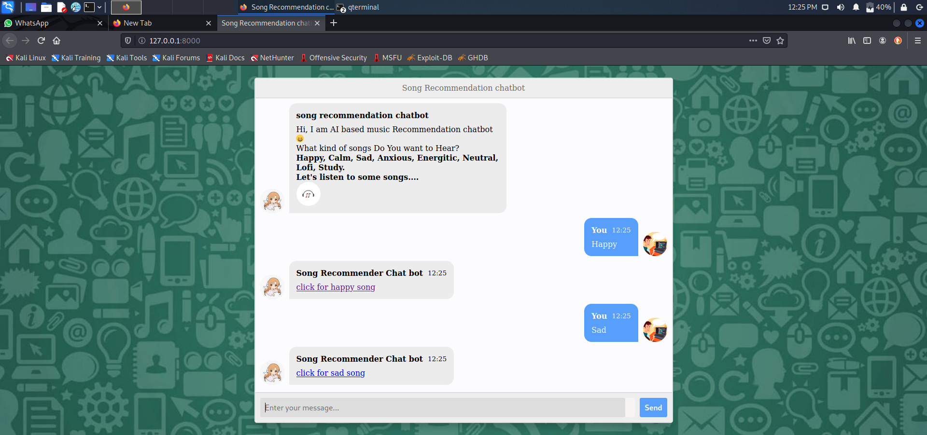
Result Analysis

Slide 22
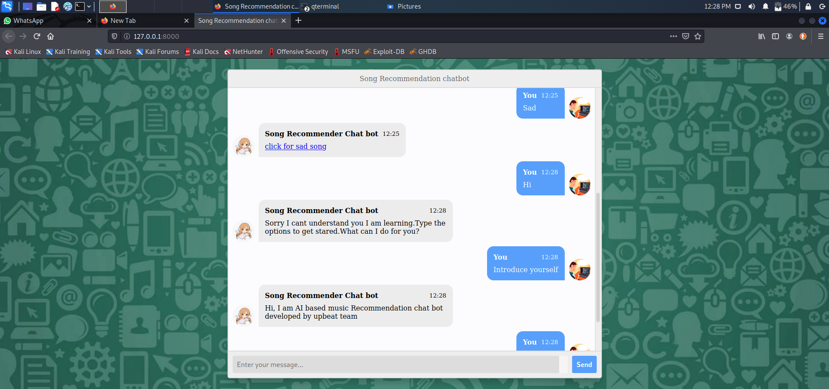

Slide 23
Conclusion
We have presented a survey and methodology for building the song recommender chat bot system. To perform this, we first identified various approaches for building a chat bot known to date.
We then evaluated the considered algorithms which are useful in building of our system in terms of their ability to work on the recommendation process of the system.
We also gathered all the requirements needed for building our system and studied the overall process involved in chat bot's working. Lastly we summarized the deployment requirements of our system.
On the conclusion note our “ Song Recommender Chat Bot System” is used to facilitate the use by people to automate and give them better music player experience. The application solves the basic needs of music listeners without troubling them as existing applications do.

Slide 24
Future work
Training corpus with deep learning algorithms to improve accuracy
Adding move recommendation system to application can be useful for users
Android application can be developed for user friendly access
Trying clustering techniques to recommend music.

Slide 25
References
[1] J. B. Schafer, D.Frankowski , J.Herlocker , and S. Sen, “Collaborative filtering recommender systems,” The Adaptive Web: Methods and Strategies of Web Personalization, pp. 291-324,2007.
[2] M. J.Pazzani and D.Billsus , “Content based recommendation systems,” The Adaptive Web: Methods and Strategies of Web Personalization, pp. 325-341, 2007.
[3] E. J. Humphrey, J. P. Bello, and Y. LeCun, “Moving beyond feature design: deep architectures and automatic feature learning in music informatics,” in Proc. 13th Int ‟ l Conf. Music Info . Retrieval, pp. 403- 408, October2012.
[4] E. J. Humphrey, J. P. Bello, and Y. LeCun, “Moving beyond feature design: deep architectures and automatic feature learning in music informatics,” in Proc. 13th Int ‟ l Conf. Music Info . Retrieval, pp. 403- 408, October2012.

Slide 26
Thank You!

